Slide 1
Molecular Biology Biol 480
Lecture 12 February 13th, 2019

Slide 2
Announcements/Assignments

Slide 3
Where were we… Text Chpt. 11
DNA replication
origins of replication—what are they? How do they serve to start replication
—DNA sequence has meaning---beyond the code for proteins.
Previous examples?
Restriction enzyme recognition sequences— specific proteins bind to unique DNA sequence
and have an effect on the DNA at that sequence

Slide 4
Where were we…
Some proteins have absolute sequence specificity. (Restriction enzymes)
Some proteins have more flexibility---can bind similar sequence—which is called the consensus sequence for that DNA-binding protein.
(Sometimes a consensus sequence has a non-variable position within the consensus).

Slide 5
Features of bacterial origins

Slide 6
Where were we…
We learned the specific roles of many proteins involved in DNA replication.
Be sure to know these proteins, their designation (how to refer to them in writing)
Know their position on replicating DNA
Know their role in DNA replication
Think about what might occur if a specific protein did not function correctly

Slide 7
Continuous and discontinuous replication
One strand (leading strand template) allows for continuous DNA synthesis in one direction.
Other strand (lagging strand template) requires DNA synthesis in the opposite direction, but it can occur in short, discontinuous stretches (maintaining a 5’-3’ activity).

Slide 8
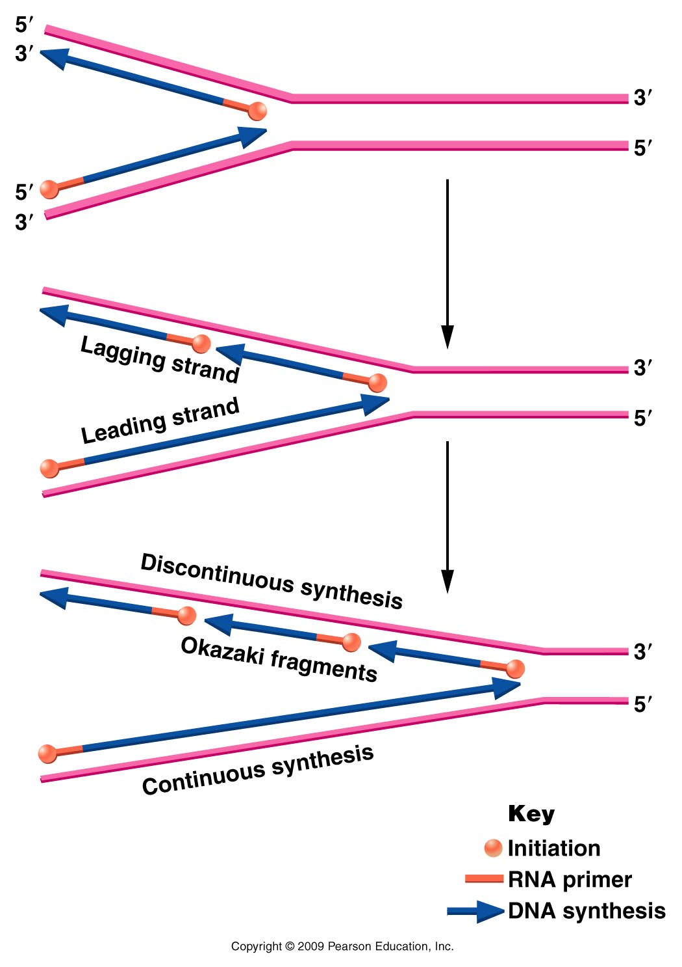
Figure 11.11
Notes:
Figure 11-11 Opposite polarity of DNA synthesis along the two strands, necessary because the two strands of DNA run antiparallel to one another and DNA polymerase III synthesizes only in one direction ( to ). On the lagging strand, synthesis must be discontinuous, resulting in the production of Okazaki fragments. On the leading strand, synthesis is continuous. RNA primers are used to initiate synthesis on both strands.

Slide 9
Models for the mechanism
Polymerases can move in one overall direction if the lagging strand template flips its orientation locally.

Slide 10
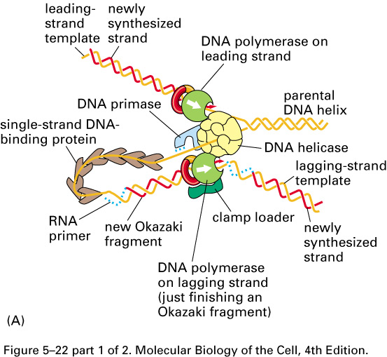

Slide 11
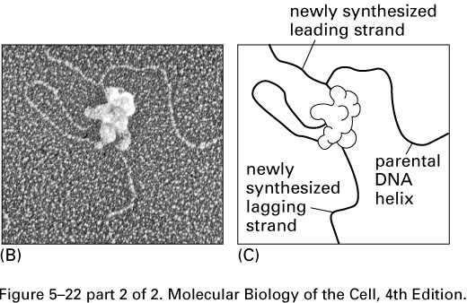
Electron microscope image!
Interpretation

Slide 12
Short fragments of DNA made from the lagging strand, called Okazaki fragments.
Eventually primers are removed and Okazaki fragments are linked into a continuous strand of DNA. (Role of
DNA pol I)
This extra work takes time so the synthesis lags behind the continuous synthesis.

Slide 13
Okazaki used a pulse-chase experiment to support the idea that some DNA was made in short pieces, which later became long pieces.
Excellent source for explanations! http://fbio.uh.cu/sites/genmol/adic/okazaki.html

Slide 14
2 experiments of Okazaki
In this experiment, Okazaki used viruses to test his hypothesis of DNA replication. By increasing the length of time he “fed” them radioactive nucleotide precursors he saw that the increase in radioactivity was accompanied by an increase in sedimentation (distance from the top of the tube) indicating an increase in length.
Labeled DNA gets longer with time

Slide 15
Okazaki confirmed that short pieces lengthen over time, but providing a short pulse of radioactive nucleotides followed by a chase of non-radioactive “cold” nucleotides.
Over time—the short radioactive pieces, lengthened.
Okazaki showed the lengthening was not due to more DNA synthesis, but by joining the short pieces.

Slide 16
An enzyme called DNA ligase was known to be able to join DNA pieces together by creating phosphodiester bonds.

Slide 17
Okasaki confirmed that short DNA fragments are joined over time by DNA ligase using mutants for DNA ligase
Only short fragments are labeled with radioactivity

Slide 18
Completion of the lagging strand
Obviously the lagging strand cannot be left as small unlinked fragments of DNA.
Equally important, newly made DNA cannot retain the primer—short pieces of RNA are not interspersed in DNA.
The primary role of DNA polymerase I is the removal of RNA primers and simultaneous replacement with DNA.

Slide 19
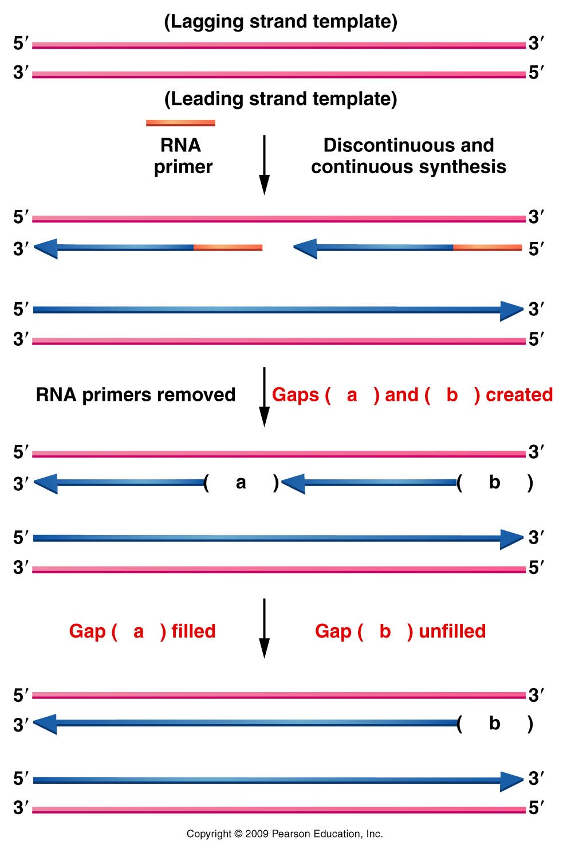
Figure 11.16
Notes:
Figure 11-16 Diagram illustrating the difficulty encountered during the replication of the ends of linear chromosomes. A gap (- -b- -) is left following synthesis on the lagging strand.

Slide 20
DNA polymerase cannot link the individual Okasaki fragments, however.
Role of yet another helper protein called DNA ligase.
Lagging strand template
Okasaki fragment 2
Okasaki fragment 1
DNA ligase—makes the phosphodiester bond

Slide 21
One final detail…
All DNA polymerases can occasionally make mistakes when reading the DNA template.
3’AGCCTCGAACGGTAATT…..(template)
5’TCGGAGCTTA
DNA polymerase III makes a mistake, adding A instead of G
DNA polymerase III

Slide 22
DNA polymerase III has built-in proofreading and error correction activity.
3’AGCCTCGAACGGTAATT…..(template)
5’TCGGAGCTTG
DNA polymerase III corrects its mistake, replacing A with G before moving on to next nucleotide
DNA polymerase III

Slide 23
Removal of a nucleotide from the end of a DNA fragment is called exonuclease activity.
All of E. coli’s DNA polymerases also have 3’-5’ exonuclease activity as part of the proofreading activity.
See table 11.2

Slide 24
**The immediate repair activity of DNA pol III in E. coli is only one mechanism of DNA repair.
Other types of DNA repair occur in prokaryotes and eukaryotes. Many involve at least some DNA synthesis by DNA polymerases.

Slide 25
Putting it together…
Observe replication animations—from basic to more detailed.
http://www.wiley.com/college/pratt/0471393878/student/animations/dna_replication/index.html
https://www.dnalc.org/resources/3d/03-mechanism-of-replication-basic.html
https://www.dnalc.org/resources/3d/04-mechanism-of-replication-advanced.html

Slide 26
What about linear chromosomes?...(eukaryotes)
A problem arises with primed replication at DNA ends.
Let’s revisit a slide

Slide 27
Figure 11.16
Notes:
Figure 11-16 Diagram illustrating the difficulty encountered during the replication of the ends of linear chromosomes. A gap (- -b- -) is left following synthesis on the lagging strand.

Slide 28
After each round of replication, the lagging strand has an unfilled gap, where primers are removed, but if no adjacent Okasaki fragment exists, the gap cannot be filled.
Since this strand serves as template in the next round of replication there is potential for continued shortening of each linear chromosome.

Slide 29
The solution? Telomeres!
Telomeres are sections of DNA at the ends of linear chromosomes that you don’t inherit from your parents.
Telomeres are created by an enzyme called telomerase.

Slide 30
Recall…
Telomerase is an interesting enzyme which uses its own built in template to copy short repeats which are added to the ends of the inherited DNA.
The template is actually RNA! (Recall TERRA?)

Slide 31
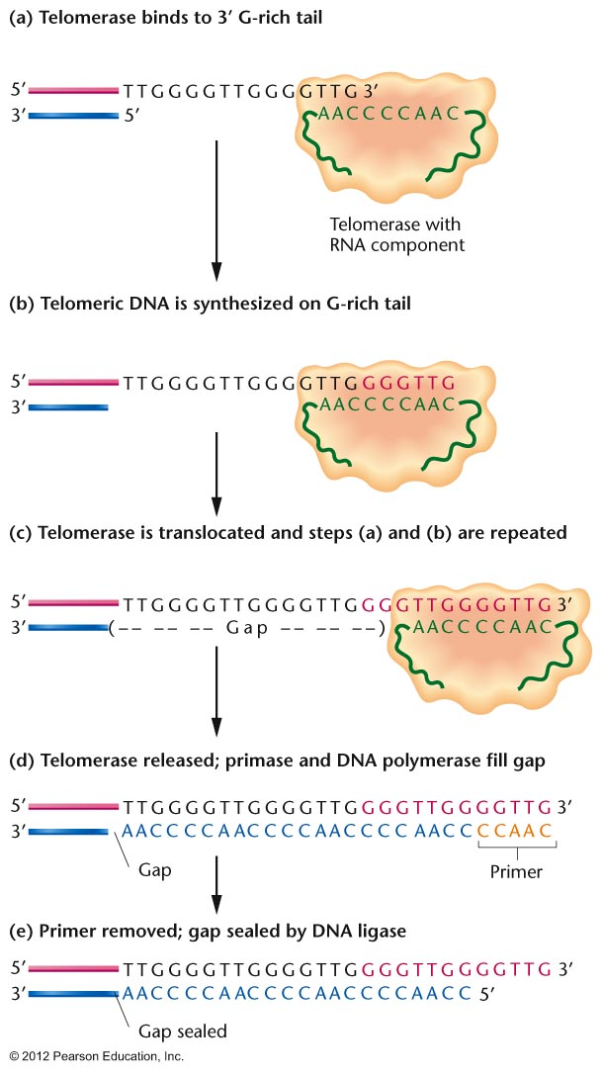
Notes:
Figure 11.17

Slide 32
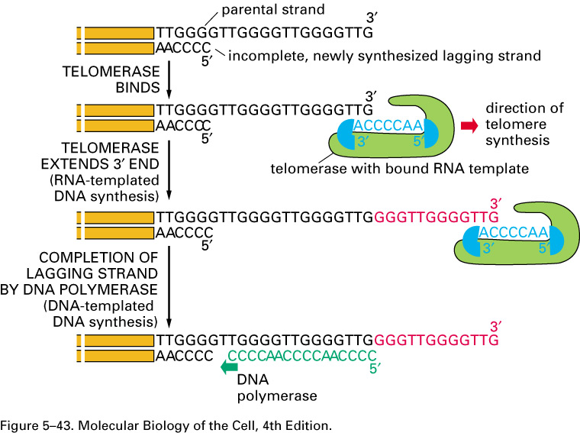

Slide 33
What do telomeres actually do?
They serve as a protection against loss of important DNA due to this replication problem.
Shortening of the ends of the chromosomes is fine if it just removes some telomere repeats.
Shortening of the ends of chromosomes is NOT FINE if it removes genes that encode essential proteins!

Slide 34
Telomeres also protect against fusion of chromosome ends.
Both the DNA repeats (telomeres) and telomere-binding proteins, serve to inhibit the natural tendency of DNA ends to interact and sometimes fuse.
When chromosomes become critically short, they tend to fuse as the ends are mistaken for DNA breaks which need repair.

Slide 35
We can see these fusions during mitosis with sister chromatids

Slide 36
We can also see chromosomes with short telomeres fusing in interphase.
Different chromosomes may fuse, which is sometimes mechanism behind chromosome translocations.

Slide 37
Telomeres are also indicators of the age of a cell/organism
Telomerase is active during development of an organism, but later stops working.
In other words, our cells do not keep adding telomere repeats to chromosomes throughout our lifetime.
Therefore we loose telomeres with each cell division (due to DNA replication).

Slide 39
So our chromosomes continue to shorten with every round of replication. As long as the shortening does not remove essential genes, there is not problem.
But the shortening serves as an indicator of the number of rounds of replication and then cell division that has taken place.

Slide 40
The more rounds of replication, the shorter the chromosomes.
This shortening actually helps a cell know when it is too old to safely remain a part of the organism.
A cell that senses it has short chromosomes is normally triggered to undergo apoptosis.

Slide 41
The shortening of telomeres is a safety mechanism to reduce the accumulation of cells with DNA that may have accumulated mutations with many rounds of replication.
The older the cell in the body, the shorter the chromosomes…
And these shorter chromosomes may have accumulated many mutations.

Slide 42
Active telomerase is found in lots of cancer cells!
Recall adults are not supposed to keep making telomerase. This insures that chromosomes shorten and that older cells eventually die by apoptosis.
Active telomerase confuses the system. Cells lose track of their age and are allowed to divide too many times.

Slide 43
The risk is accumulation of errors/mutations in the DNA due to too many rounds of replication.
The mutations are random (occurring in any place in the genome, and in potentially any gene(s), but the chance of affecting critical cell cycle regulation genes goes up.

Slide 44
If cell cycle genes are dysregulated, cell cycle may occur to often, too fast, or in tissues where cells should no longer divide.
Apoptosis may be inhibited.
Hallmarks of the disease cancer.

